Slide 1
Sequential Logic

Slide 2
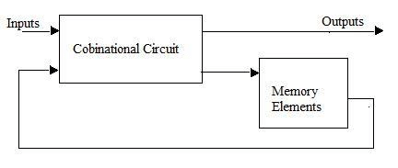
Sequential Circuits
The outputs of the circuit will depends upon the present inputs as well as on the sequence of the previous outputs of the circuits.
It is basically combination of combinational circuit and memory unit.

Slide 3
Sequential Circuits
Combinational Circuit | Sequential Circuit
Logic gates are the basic elements used. | Flip flops are the basic elements used.
It consists of input, output variables and logic gates inter connection. | It consists of input, output variables ,logic gates inter connection and memory unit.
No memory unit present. | Present
Outputs can be calculated from the function with input. | Output depends upon present inputs as well as past outputs.
Input triggers the combinational circuit. | Clock pulse and previous outputs triggers the S C

Slide 4
Latch
Latch is storage device. A latch is constructed from the cross coupled NAND or NOR gates.
The outputs of Latch are compliment of each other.
i.e. Q≠Q’

Slide 5
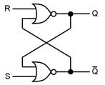
SR Latch
S | R | Q | Q’
0 | 0 | 1 | 1
0 | 1 | 0 | 1
1 | 0 | 1 | 0
1 | 1 | Not used | Not used
SR latch using NOR gates
Case I
When S = 1 and R =0; Q = 1 and Q’ = 0
When S = 0 and R = 0; Q = 1 and Q’ = 0 ( Memory)
Case II
When S = 0 and R = 1; Q = 0 and Q’ = 1
When S = 0 and R = 0; Q = 0 and Q’ = 1 (Memory)
Case III
When S = 1 and R = 1; Q = 0 and Q’ = 0 [Not Used]
A | B | F
0 | 0 | 1
0 | 1 | 0
1 | 0 | 0
1 | 1 | 0

Slide 6
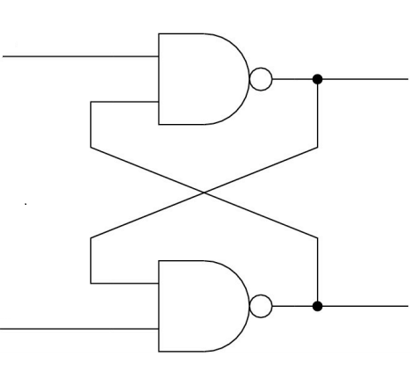
SR Latch
S
R
Q
Q’
SR latch using NAND gates
S | R | Q | Q’
0 | 0 | Not used | Not used
0 | 1 | 1 | 0
1 | 0 | 0 | 1
1 | 1 | Memory | Memory
A | B | F
0 | 0 | 1
0 | 1 | 1
1 | 0 | 1
1 | 1 | 0

Slide 7

Clock Pulse and Triggering
Varying Signal that triggers or control the operation of Flip flops.
Triggering Methods
Level Triggering
Edge Triggering

Slide 8
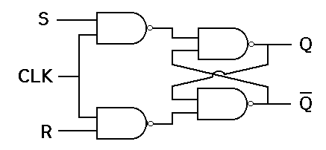
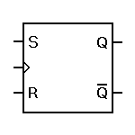
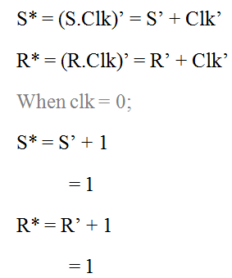
SR Flip Flop
Clk
S* | R* | Q | Q’
0 | 0 | Not used | Not used
0 | 1 | 1 | 0
1 | 0 | 0 | 1
1 | 1 | Memory | Memory
TT of SR latch using NAND

Slide 9
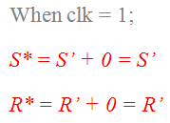
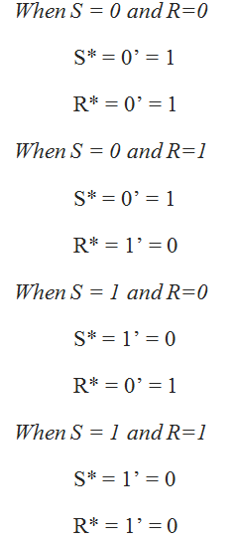
TT of SR flip flop
Clk | S | R | Q | Q’
0 | x | x | Mem | Mem
1 | 0 | 0 | Mem | Mem
1 | 0 | 1 | 0 | 1
1 | 1 | 0 | 1 | 0
1 | 1 | 1 | Invalid | Invalid

Slide 10
SR Flip Flop
Clk | S | R | Q _{n+1}
0 | x | x | Q_{n}
1 | 0 | 0 | Q_{n}
1 | 0 | 1 | 0
1 | 1 | 0 | 1
1 | 1 | 1 | Not used
Q_{n} | S | R | Q _{n+1}
0 | 0 | 0 | 0
0 | 0 | 1 | 0
0 | 1 | 0 | 1
0 | 1 | 1 | x
1 | 0 | 0 | 1
1 | 0 | 1 | 0
1 | 1 | 0 | 1
1 | 1 | 1 | x
Truth table of SR flip flop
Q_{n} | Q _{n+1} | S | R
0 | 0 | 0 | x
0 | 1 | 1 | 0
1 | 0 | 0 | 1
1 | 1 | x | 0
Characteristics table of SR flip flop
Q_{n+1} = Q_{n}R’ + S
Excitation table of SR flip flop

Slide 11
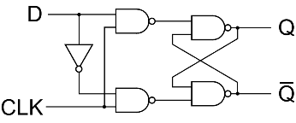
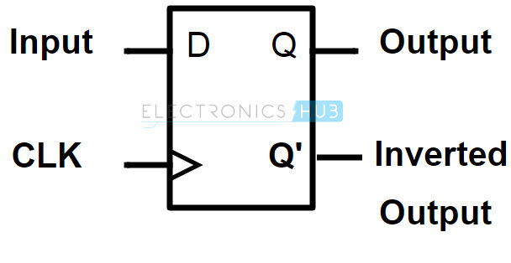
D Flip Flop
S
R
Clk | S | R | Q _{n+1}
0 | x | x | Q_{n}
1 | 0 | 0 | Q_{n}
1 | 0 | 1 | 0
1 | 1 | 0 | 1
1 | 1 | 1 | Not used
Clk | D | Q_{n+1}
0 | x | Q_{n}
1 | 0 | 0
1 | 1 | 1
TT of D flip flop
TT of SR flip flop

Slide 12
D Flip Flop
Clk | D | Q_{n+1}
0 | x | Q_{n}
1 | 0 | 0
1 | 1 | 1
Q_{n} | D | Q_{n+1}
0 | 0 | 0
0 | 1 | 1
1 | 0 | 0
1 | 1 | 1
TT of D flip flop
Characteristics of D flip flop
Q_{n+1} = D
Q_{n} | Q_{n+1} | D
0 | 0 | 0
0 | 1 | 1
1 | 0 | 0
1 | 1 | 1
Excitation of D flip flop

Slide 13
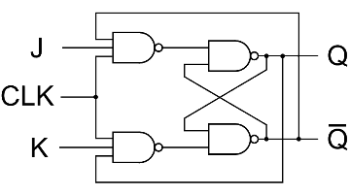
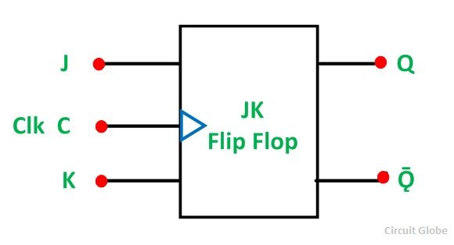
JK Flip Flop
CLK | S | R | Q_{n+1}
0 | X | X | Q_{n}
1 | 0 | 0 | Q_{n}
1 | 0 | 1 | 0
1 | 1 | 0 | 1
1 | 1 | 1 | Invalid
CLK | J | K | Q_{n+1}
0 | X | X | Q_{n}
1 | 0 | 0 | Q_{n}
1 | 0 | 1 | 0
1 | 1 | 0 | 1
1 | 1 | 1 | Q’_{n}
Toggling
T.T for S-R Flip-Flop
T.T for J-K Flip-Flop

Slide 14
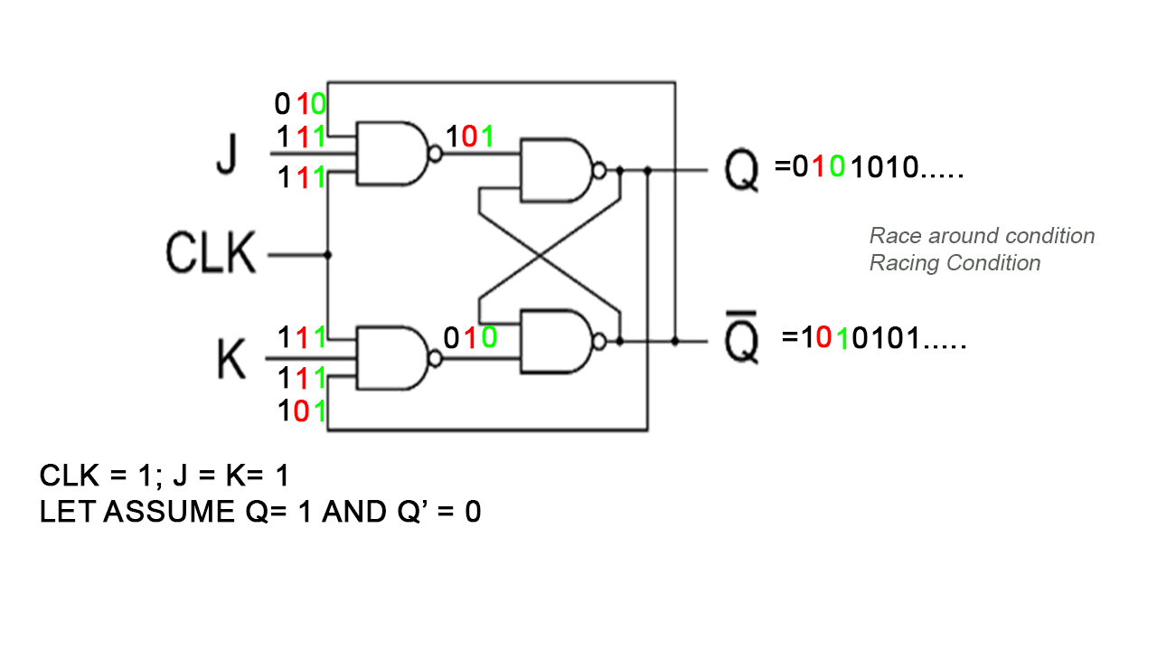
JK Flip Flop

Slide 15
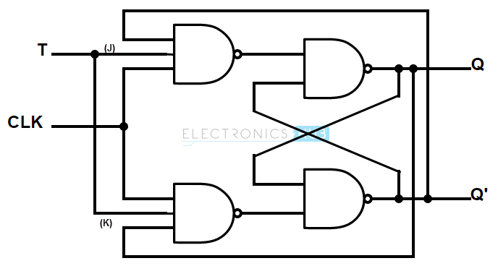
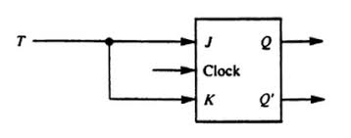
T Flip Flop
CLK | J | K | Q_{n+1}
0 | X | X | Q_{n}
1 | 0 | 0 | Q_{n}
1 | 0 | 1 | 0
1 | 1 | 0 | 1
1 | 1 | 1 | Q_{n}’
CLK | T | Q_{n+1}
0 | X | Q_{n}
1 | 0 | Q_{n}
1 | 1 | Q’_{n}
T.T for T Flip-Flop
T.T for J-K Flip-Flop

Slide 16
T Flip Flop
CLK | T | Q_{n+1}
0 | X | Q_{n}
1 | 0 | Q_{n}
1 | 1 | Q_{n}’
Q_{n} | T | Q_{n+1}
0 | 0 | 0
0 | 1 | 1
1 | 0 | 1
1 | 1 | 0
T.T for T Flip-Flop
Characteristics table for T Flip-Flop
Q_{n} | Q_{n+1} | T
0 | 0 | 0
0 | 1 | 1
1 | 0 | 1
1 | 1 | 0
Excitation Table for T Flip-Flop

Slide 17
JK Flip Flop
CLK | J | K | Q_{n+1}
0 | X | X | Q_{n}
1 | 0 | 0 | Q_{n}
1 | 0 | 1 | 0
1 | 1 | 0 | 1
1 | 1 | 1 | Q’_{n}
Q_{n} | J | K | Q_{n+1}
0 | 0 | 0 | 0
0 | 0 | 1 | 0
0 | 1 | 0 | 1
0 | 1 | 1 | 1
1 | 0 | 0 | 1
1 | 0 | 1 | 0
1 | 1 | 0 | 1
1 | 1 | 1 | 0
T.T for J-K Flip-Flop
Q_{n} | Q_{n+1} | J | _{K}
0 | 0 | 0 | x
0 | 1 | 1 | x
1 | 0 | x | 1
1 | 1 | x | 0
Characteristics Table for J-K Flip-Flop
Excitation table for J-K Flip-Flop

Slide 18
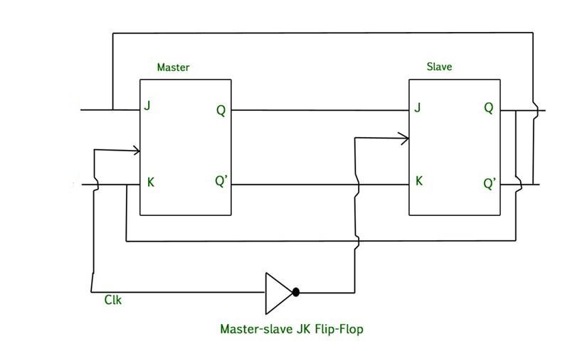
Master - Slave JK Flip Flop
Combination of 2 JK flip-flops in series.
One acts as ‘master’ and the other as ‘slave’
It also includes an Inverter(Not Gate).

Slide 19
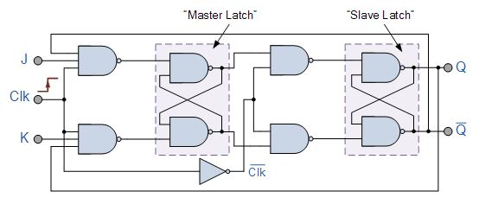
Master Slave JK Flip Flop

Slide 20
Master Slave JK Flip Flop
When the clock is high, master is operational but slave is not operational(it will keep memory)
When the clock is low, master is not functional but slave is. The output at slave is fed back to master but the clock is low. So, In this case effect of feedback is eliminated(which eliminates racing)
CLK | J | K | Q_{n+1}
0 | X | X | Q_{n}
1 | 0 | 0 | Q_{n}
1 | 0 | 1 | 0
1 | 1 | 0 | 1
1 | 1 | 1 | Q’_{n}
T.T for J-K Flip-Flop

Slide 21
Conversion of Flip-Flop (Realization of one Flip-Flop using other Flip-Flop)
Steps for Flip-Flop Conversion
Make Characteristics table for required flip-flop.
Make Excitation table for available flip-flop.
Write Boolean expression for available flip-flop.
Draw the Block Diagram.

Slide 22
Example 1 – JK to D
Required flip-flop : D, Available flip-flop : JK
Q_{n} | D | Q_{n+1} | J | K
0 | 0 | 0 | 0 | x
0 | 1 | 1 | 1 | x
1 | 0 | 0 | x | 1
1 | 1 | 1 | x | 0
Q_{n} | Q_{n+1} | J | K
0 | 0 | 0 | x
0 | 1 | 1 | x
1 | 0 | x | 1
1 | 1 | x | 0
Excitation table of JK ( available f/f))
Char table of D ( required f/f))
Using K map
J = D
K = D’
D
J
K
Q_{n}
Q’_{n}
Clk
D’

Slide 23
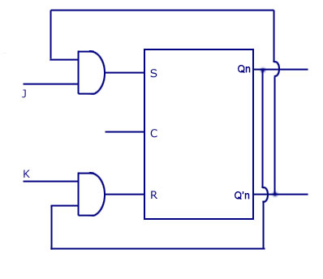
Example 2 – SR to JK
Required flip-flop : JK, Available flip-flop : SR
Q_{n} | J | K | Q_{n+1} | S | R
0 | 0 | 0 | 0 | o | x
0 | 0 | 1 | 0 | 0 | x
0 | 1 | 0 | 1 | 1 | 0
0 | 1 | 1 | 1 | 1 | 0
1 | 0 | 0 | 1 | x | 0
1 | 0 | 1 | 0 | 0 | 1
1 | 1 | 0 | 1 | x | 0
1 | 1 | 1 | 0 | 0 | 1
Q_{n} | Q_{n+1} | S | R
0 | 0 | 0 | x
0 | 1 | 1 | 0
1 | 0 | 0 | 1
1 | 1 | x | 0
From K map
S = Q_{n}’J R = Q_{n}K

Slide 24
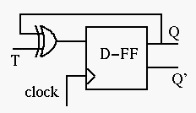
Example 3 – T to D
Required flip-flop : T Available flip-flop : D

Slide 25
Direct Inputs
Also called asynchronous inputs.
Flip-flop have control over the outputs (Q and Q’) regardless of clock signal.
These inputs are called the preset (PRE) and clear (CLR).
When preset = 0, Q equals to 1
When clear = 0, Q equals to 0

Slide 26
State Diagram and State Table
P.S
N.S
x/y
Q_{n}
x=input
y=output
Q_{n+1}
The relationship that exists among the inputs, outputs, present states and next states can be specified by either the State Diagram or State Table.

Slide 27
Design Procedure for Sequential Circuit
Obtain the state table.
Reduce the no. of state using state reduction method(If possible)
Do state assignment(If required)
Determine the number of flip flop required.
Derive circuit excitation table from state table/diagram.
Obtain the expression for circuit output and flip flop output.
Implement the circuit.

Slide 28
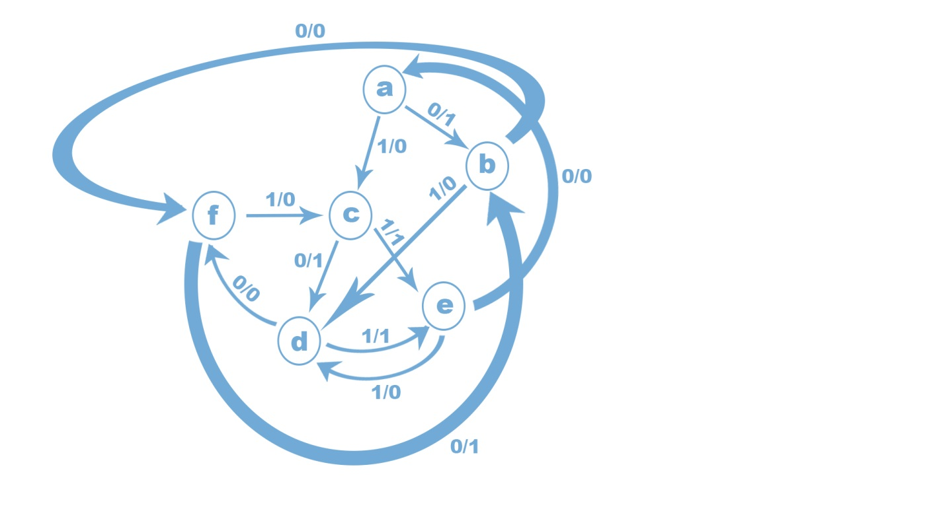
State Reduction and Assignment

Slide 29
Present State | Next State |  | Output
 | x=0 | x=1 | x=0 | X=1
A | B | C | 1 | 0
B | F | D | 0 | 0
C | D | E | 1 | 1
D | F | E | 0 | 1
E | A | D | 0 | 0
F | B | C | 1 | 0
Present State | Next State |  | Output
 | x=0 | x=1 | x=0 | X=1
A | B | C | 1 | 0
B | A | D | 0 | 0
C | D | E | 1 | 1
D | A | E | 0 | 1
E | A | D | 0 | 0

Slide 30
Present State | Next State |  | Output
 | x=0 | x=1 | x=0 | X=1
A | B | C | 1 | 0
B | A | D | 0 | 0
C | D | B | 1 | 1
D | A | B | 0 | 1
A
0/0
00
0/1
0/0
1/0
0/1
1/0
C
1/1
B
0/0
10
1/1
0/0
01
0/1
1/0
D
0/1
1/0
1/1
11
1/1

Slide 31
Design a sequential circuit from the following state diagram using T flip-flop.
0/0
00
1/0
1/1
1/0
0/1
01
10
0/0
0/0
11
1/0
Present State |  | Next State |  |  |  | Output
 |  | x=0 |  | x=1 |  | x=0 | X=1
0 | 0 | 0 | 0 | 0 | 1 | 0 | 0
0 | 1 | 1 | 1 | 0 | 1 | 0 | 0
1 | 0 | 1 | 0 | 0 | 0 | 1 | 1
1 | 1 | 1 | 0 | 1 | 1 | 0 | 0

Slide 32
0/0
00
1/0
1/1
1/0
0/1
01
10
0/0
0/0
11
1/0
Present State |  |  | Next State |  | Output (y) | Using T f/f
Q_{a} | Q_{b} | x | Q_{a}⁺ | Q_{b}⁺ |  | T_{a} | T_{b}
0 | 0 | 0 | 0 | 0 | 0 | 0 | 0
0 | 0 | 1 | 0 | 1 | 0 | 0 | 1
0 | 1 | 0 | 1 | 1 | 0 | 1 | 0
0 | 1 | 1 | 0 | 1 | 0 | 0 | 0
1 | 0 | 0 | 1 | 0 | 1 | 0 | 0
1 | 0 | 1 | 0 | 0 | 1 | 1 | 0
1 | 1 | 0 | 1 | 0 | 0 | 0 | 1
1 | 1 | 1 | 1 | 1 | 0 | 0 | 0
Ta = Qa’.Qb.x’ +Qa.Qb’x
Tb = Qa’.Qb’.x + Qa.Qb.x’
Y = Qa.Qb’.x’ + Qa. Qb’ . x
= Qa.Qb’(x+x’)
= Qa.Qb’

Slide 33
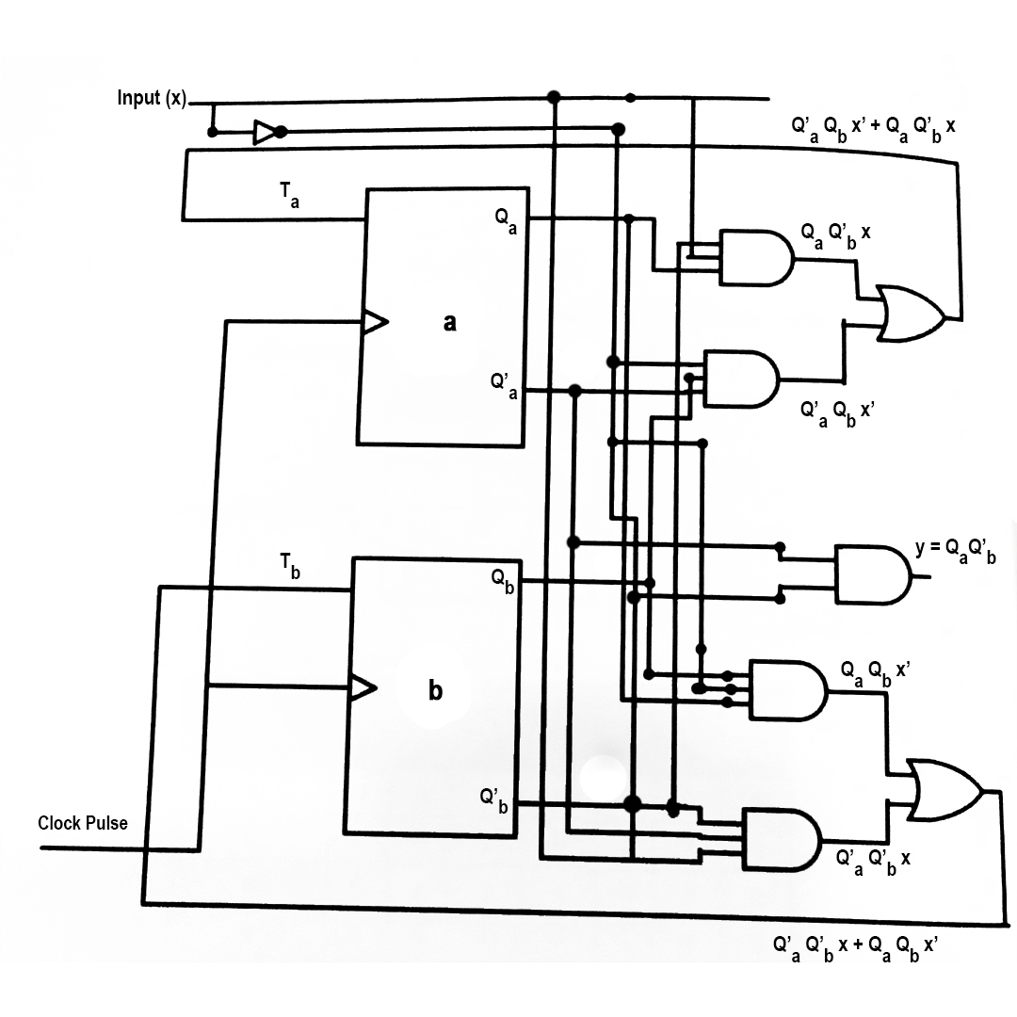
Ta = Qa’.Qb.x’ +Qa.Qb’x
Tb = Qa’.Qb’.x + Qa.Qb.x’
Y = Qa.Qb’.x’ + Qa. Qb’ . x
= Qa.Qb’(x+x’)
= Qa.Qb’

Slide 34
From the state diagram given below, Design a Sequential circuit using
SR flip-flop.
0/0
00
1/0
1/1
1/0
Present State |  |  | Next State |  | Output (y) | Using SR f/f
Q_{a} | Q_{b} | x | Q_{a}⁺ | Q_{b}⁺ |  | S_{a} | R_{a} | S_{b} | R_{b}
0 | 0 | 0 | 0 | 0 | 0 | o | x | 0 | x
0 | 0 | 1 | 0 | 1 | 0 | 0 | x | 1 | 0
0 | 1 | 0 | 1 | 1 | 0 | 1 | 0 | x | 0
0 | 1 | 1 | 0 | 1 | 0 | 0 | x | x | 0
1 | 0 | 0 | 1 | 0 | 0 | x | 0 | 0 | x
1 | 0 | 1 | 0 | 0 | 1 | 0 | 1 | x | x
1 | 1 | 0 | 1 | 0 | 0 | x | o | 0 | 1
1 | 1 | 1 | 1 | 1 | 0 | x | 0 | x | 0
01
10
0/0
0/0
0/0
11
1/0

Slide 35
Present State |  |  | Next State |  | Output (y) | Using SR f/f
Q_{a} | Q_{b} | x | Q_{a}⁺ | Q_{b}⁺ |  | S_{a} | R_{a} | S_{b} | R_{b}
0 | 0 | 0 | 0 | 0 | 0 | o | x | 0 | x
0 | 0 | 1 | 0 | 1 | 0 | 0 | x | 1 | 0
0 | 1 | 0 | 1 | 1 | 0 | 1 | 0 | x | 0
0 | 1 | 1 | 0 | 1 | 0 | 0 | x | x | 0
1 | 0 | 0 | 1 | 0 | 0 | x | 0 | 0 | x
1 | 0 | 1 | 0 | 0 | 1 | 0 | 1 | o | x
1 | 1 | 0 | 1 | 0 | 0 | x | o | 0 | 1
1 | 1 | 1 | 1 | 1 | 0 | x | 0 | x | 0
S_{a}(Q_{a},Q_{b},x) = Σ (2) & d(Q_{a},Q_{b},x) = Σ (4,6,7)
R_{a}(Q_{a},Q_{b},x) = Σ (5) & d(Q_{a},Q_{b},x) = Σ (0,1,3)
S_{b}(Q_{a},Q_{b},x) = Σ (1) & d(Q_{a},Q_{b},x) = Σ (2,3,7)
R_{b}(Q_{a},Q_{b},x) = Σ (6) & d(Q_{a},Q_{b},x) = Σ (0,4,5)
y(Q_{a},Q_{b},x) = Σ (5)

Slide 36
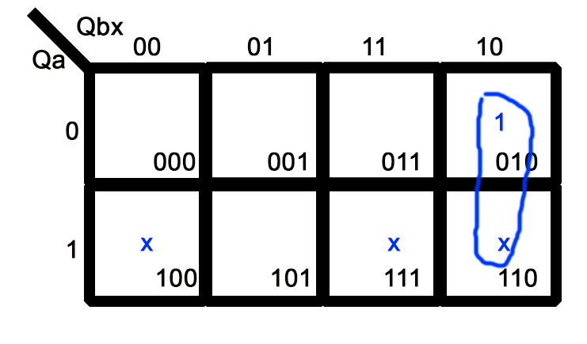
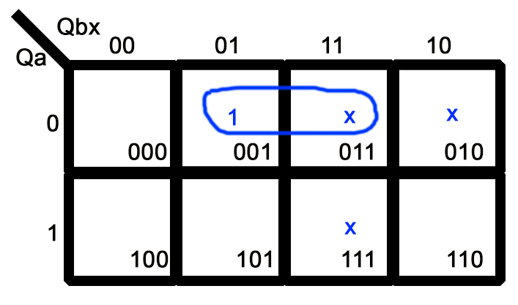
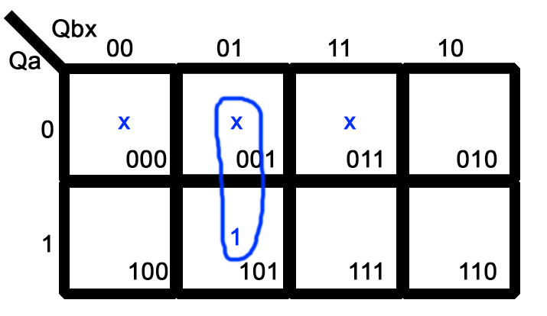
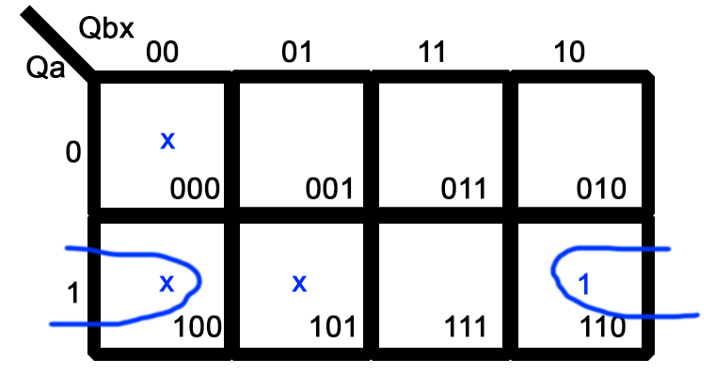
S_{a}(Q_{a},Q_{b},x) = Σ (2) & d(Q_{a},Q_{b},x) = Σ (4,6,7)
S_{a} = Q_{b}x'
S_{b}(Q_{a},Q_{b},x) = Σ (1) & d(Q_{a},Q_{b},x) = Σ (2,3,7)
S_{b} = Q'_{a}x
R_{a}(Q_{a},Q_{b},x) = Σ (5) & d(Q_{a},Q_{b},x) = Σ (0,1,3)
R_{a} = Q'_{b}x
R_{b}(Q_{a},Q_{b},x) = Σ (6) & d(Q_{a},Q_{b},x) = Σ (0,4,5)
R_{b} = Q_{a}x'

Slide 37
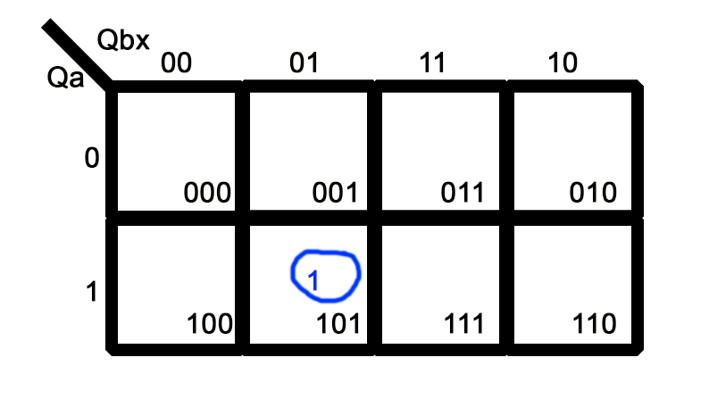
y(Q_{a},Q_{b},x) = Σ (5)
y = Q_{a}Q'_{b}x
y = Q_{a}Q'_{b}x
S_{a} = Q_{b}x'
S_{b} = Q'_{a}x
R_{a} = Q'_{b}x
R_{b} = Q_{a}x'

Slide 38
y = Q_{a}Q'_{b}x S_{a} = Q_{b}x' S_{b} = Q'_{a}x R_{a} = Q'_{b}x R_{b} = Q_{a}x'

Slide 39
Design a sequential circuit from the following state diagram using S-R flip-flop.
0/1
00
1/0
1/0
1/1
0/0
01
10
0/1
1/0
11
0/1

